Slide 1



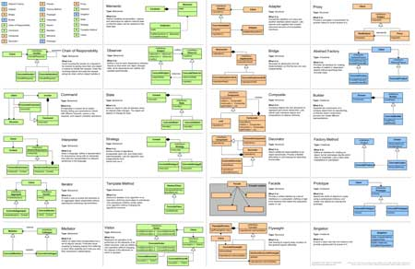
Design Patterns: Behavioral Design Patterns
General and reusable solutions to common problems in software design
High-Quality Code
SoftUni Team
Technical Trainers
http://softuni.bg
Software University

Slide 2

Table of Contents
Behavioral Design Patterns:
Chain of Responsibility, Iterator, Command, Template Method, Strategy, Mediator, Memento, State, Interpreter, Visitor
Architectural Design Patterns:
MV*

Slide 3
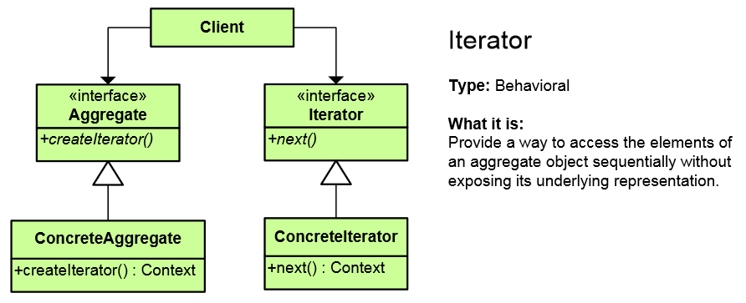
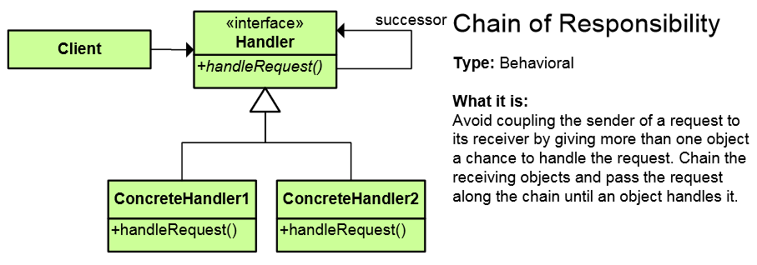
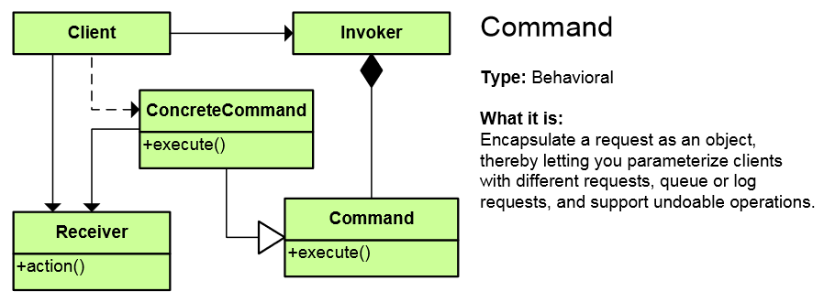
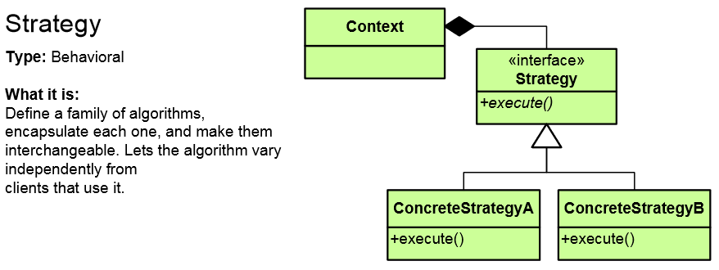
Behavioral Patterns

Slide 4
Behavioral Patterns
Concerned with communication (interaction) between the objects
Either with the assignment of responsibilities between objects
Or encapsulating behavior in an object and delegating requests to it
Increase flexibility in carrying out communication across classes

Slide 5
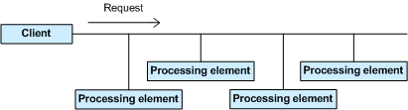
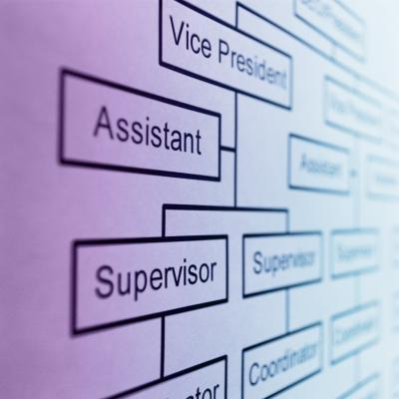
Chain of Responsibility Pattern
Allows you to pass a request to form an object to the next until the request is fulfilled
Analogous to exception handling
Simplifies object interconnections
Each sender keeps a single reference to the next
http://www.dofactory.com/net/chain-of-responsibility-design-pattern

Slide 6
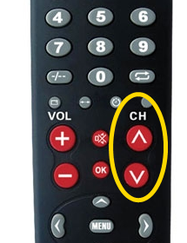
Iterator Pattern
Access to the elements of a complex object without revealing its actual presentation
Various ways of data structure traversing
Unified interface for iterating over various data structures
foreach loops in C# use the Iterator pattern
http://www.dofactory.com/net/iterator-design-pattern

Slide 7
Iterator – Example
public interface IEnumerator {
bool MoveNext();
object Current { get; }
void Reset(); }
public interface IEnumerable {
IEnumerator GetEnumerator();
}
private class ConcreteEnumerator : IEnumerator {
// Implement IEnumerator interface
}
var enumerator = someObject.GetEnumerator();
enumerator.Reset();
while (enumerator.MoveNext()) {
// work with enumerator.Current
}

Slide 8
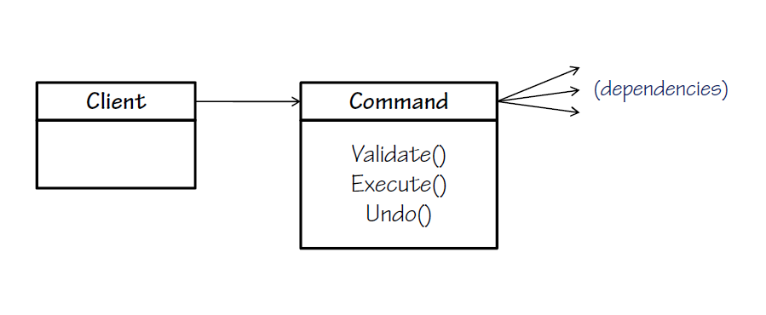
Command Pattern
An object encapsulates all the information needed to call a method at a later time
Letting you parameterize clients with different requests, queue or log requests, and support undoable operations
In .NET, WPF and Silverlight encapsulate a request to call a method with parameters
http://www.dofactory.com/net/command-design-pattern

Slide 9
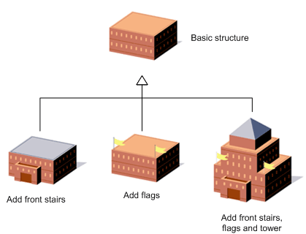
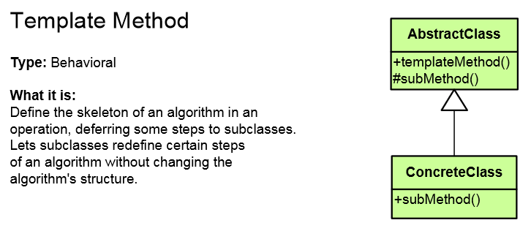
Template Method Pattern
Defines the base of an algorithm in a method, leaving some implementation to its subclasses
Template Method allows the subclasses to redefine the implementation of some of the parts of the algorithm
Doesn't let the subclasses change the algorithm structure
Relies on inheritance; Strategy on composition
http://www.dofactory.com/net/template-method-design-pattern

Slide 10
Template Method – Example
public abstract class HotDrink {
public void PrepareRecipe()
{
BoilWater(); Brew(); PourInCup(); AddSpices();
}
protected abstract void Brew();
protected abstract void AddSpices();
private void BoilWater() { ... }
private void PourInCup() { ... }
}
public class Coffee : HotDrink {
protected override void Brew() { ... }
protected override void AddSpices() { ... }
}
public class Tea : HotDrink {
protected override void Brew() { ... }
protected override void AddSpices() { ... }
}
Implemented by subclasses

Slide 11
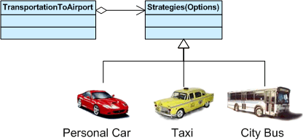
Strategy Pattern
Encapsulates an algorithm inside a class
Making each algorithm replaceable by others
All the algorithms can work with the same data transparently
The client can work with each algorithm transparently
http://www.dofactory.com/net/strategy-design-pattern

Slide 12
Strategy Pattern – Example
abstract class SortStrategy {
public abstract void Sort(IList<object> list);
}
class QuickSort : SortStrategy {
public override void Sort(IList<object> list) { ... }
}
class MergeSort : SortStrategy {
public override void Sort(IList<object> list) { ... }
}
class SortedList {
private IList<object> list = new List<object>();
public void Sort(SortStrategy strategy) {
// sortStrategy can be passed in constructor
sortStrategy.Sort(list);
}
}

Slide 13
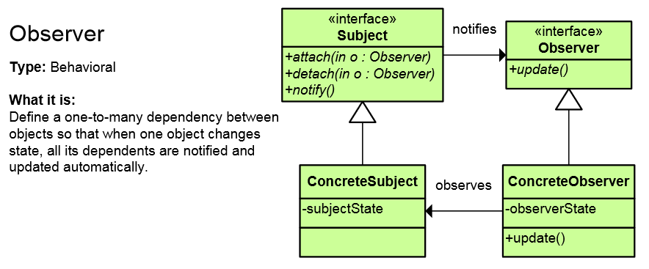
Observer Pattern
Presents interface allowing object to communicate without any concrete knowledge about each other
Also known as Publish-Subscribe pattern
Object to inform other object about its state, without the knowledge which are these objects
In .NET Framework events and event handlers use this pattern
http://www.dofactory.com/net/observer-design-pattern

Slide 14
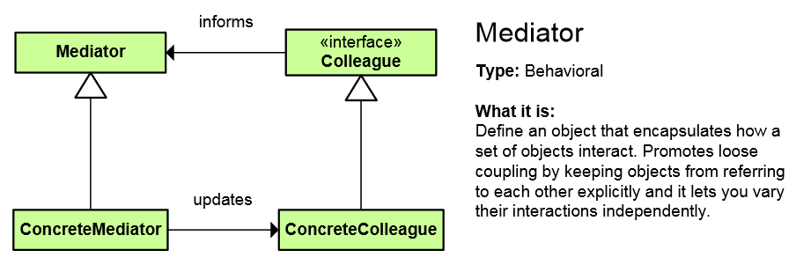
Mediator Pattern
Simplifies communication between classes
Define an object that encapsulates how a set of objects interact
Promotes loose coupling by keeping objects from referring to each other explicitly
Lets you vary their interaction independently
http://www.dofactory.com/net/mediator-design-pattern

Slide 15
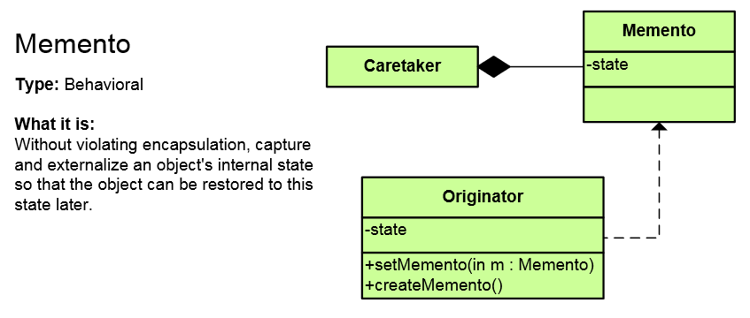
Memento Pattern
Capture and restore an object's internal state
Promote undo or rollback to full object status at a previous time
Encapsulates a “checkpoint” capability
http://www.dofactory.com/net/memento-design-pattern

Slide 16
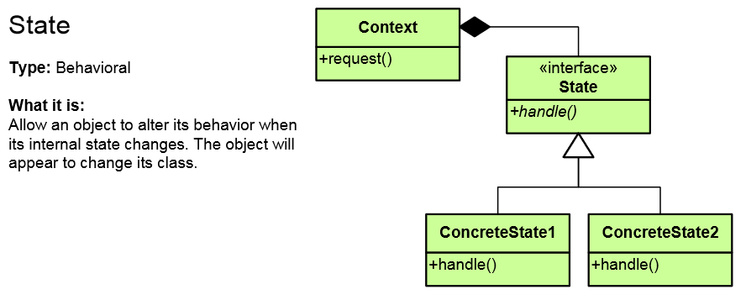
State Pattern
Alter an object's behavior when its state changes
Change behavior of the object with each state
Encapsulate the logic of each state into an object
Allow dynamic state discovery
Make unit testing easier
An object-oriented state machine (automaton)
http://www.dofactory.com/net/state-design-pattern

Slide 17
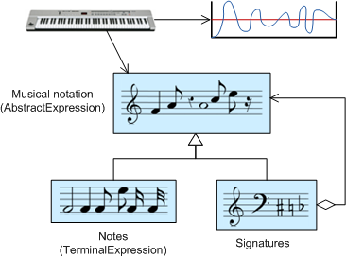
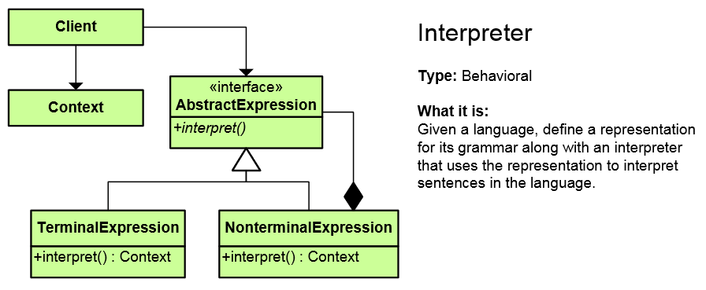
Interpreter Pattern
A way to include language(formal grammar) elements in a program
Define a representation for the grammar
Define an interpreter that uses the representation to interpret sentences in the language
http://www.dofactory.com/net/interpreter-design-pattern

Slide 18
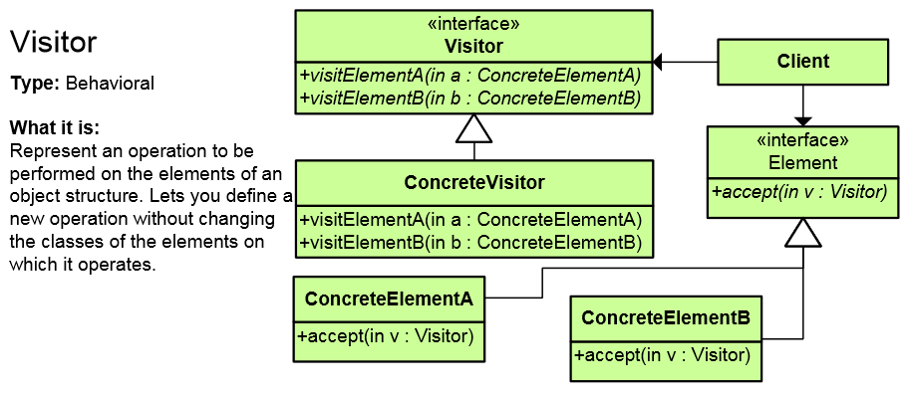
Visitor Pattern
Defines a new operation to a class without changing the elements of the class
The classic technique for recovering lost type information
Do the right thing based on the type of two objects
Double dispatch
http://www.dofactory.com/net/visitor-design-pattern

Slide 19
Other Behavioral Patterns
Null Object
Designed to act as a default value of an object
In .NET: String.Empty, EventArgs.Empty, etc.
Hierarchical visitor (Composite + Visitor)
Visit every node in a hierarchical data structure
Protocol stack (Upper Layer / Lower Layer)
Scheduled-task
Single-serving visitor (Use and then delete)
Specification pattern (Combine rules (and/or))

Slide 20
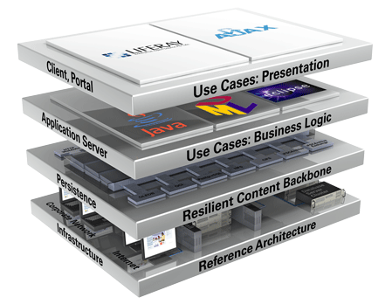
Architectural patterns

Slide 21
Model-View-Controller (MVC)
Model-View-Controller (MVC) architecture
Separates the business logic from application data and presentation
Model
Keeps the application state (data)
View
Displays the data to the user (shows UI)
Controller
Handles the interaction with the user

Slide 22

MVC and Multi-Tier Architecture
MVC does not replace the multi-tier architecture
Both are usually used together
Typical multi-tier architecture can use MVC
To separate logic, data and presentation
Controllers (Business Logic)
Views (Presentation)
Model (Data)
Data Access Logic

Slide 23
Model-View-Presenter (MVP)
Model-View-Presenter (MVP) is UI design pattern similar to MVC
Model
Keeps application data (state)
View
Presentation – displays the UI and handles UI events (keyboard, mouse, etc.)
Presenter
Presentation logic (prepares data taken from the model to be displayed in certain format)

Slide 24
Model-View-ViewModel (MVVM)
Model-View-ViewModel (MVVM) is architectural pattern for modern UI development
Invented by Microsoft for use in WPF and Silverlight
Based on MVC, MVP and Martin Fowler's Presentation Model pattern
Officially published in the Prism project (Composite Application Guidance for WPF and Silverlight)
Separates the "view layer" (state and behavior) from the rest of the application

Slide 25
MVVM Structure
Model
Keeps the application data / state representation
E.g. data access layer or ORM framework
View
UI elements of the application
Windows, forms, controls, fields, buttons, etc.
ViewModel
Data binder and converter that changes the Model information into View information
Exposes commands for binding in the views

Slide 26
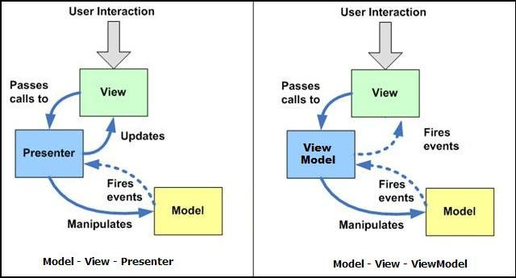
MVP vs. MVVM Patterns
MVVM is like MVP but leverages the platform's built-in bi-directional data binding mechanisms

Slide 27
Design Patterns in the .NET Framework
Iterator pattern in foreach loops in C#
Observer pattern – events and event handlers
Adapter pattern is used in ADO.NET
Decorator: CryptoStream decorates Stream
Command: WPF and Silverlight encapsulate a request to call a method with parameters
Façade pattern used in many Win32 API based classes to hide Win32 complexity
Chain of Responsibility is similar to exceptions
String.Empty is a Null Object

Slide 28

Design Patterns: Behavioral Design Patterns
Exercises in Class

Slide 29

Summary
Behavioral Design Patterns:
Chain of Responsibility, Iterator, Command, Template Method, Strategy, Mediator, Memento, State, Interpreter, Visitor
Architectural Design Patterns:
MVC
MVP
MVVM

Slide 30









Design Patterns: Behavioral Design Patterns
http://softuni.org/courses/high-quality-code

Slide 31

License
This course (slides, examples, demos, videos, homework, etc.) is licensed under the "Creative Commons Attribution-NonCommercial-ShareAlike 4.0 International" license
Attribution: this work may contain portions from
"Fundamentals of Computer Programming with C#" book by Svetlin Nakov & Co. under CC-BY-SA license
"C# Part I" course by Telerik Academy under CC-BY-NC-SA license

Slide 32






Free Trainings @ Software University
Software University Foundation – softuni.org
Software University – High-Quality Education, Profession and Job for Software Developers
softuni.bg
Software University @ Facebook
facebook.com/SoftwareUniversity
Software University @ YouTube
youtube.com/SoftwareUniversity
Software University Forums – forum.softuni.bg

